Slide 1
Phantom S890
4K Streaming Camera

Slide 2
Phantom S890 Key features
Streaming camera
  Flex 4K sensor, in Color or Mono
  CXP6 technology to stream – no RAM in camera
  Up to 8 Gpx/sec of data - 4 banks of 4 CXP6 channels
  CXP6 protocol compliant, with exceptions:
    Stitching data from separate frame grabbers
    Header space in image for data
    Rolling / Global shutter selection
    IRIG Signal capability
  Gen-i-Cam protocol to control streamer
    No Phantom Control Software
  Compatible with Euresys & IO Industries
phantomhighspeed.com

Slide 3
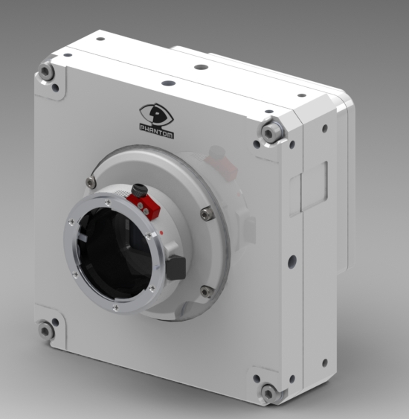
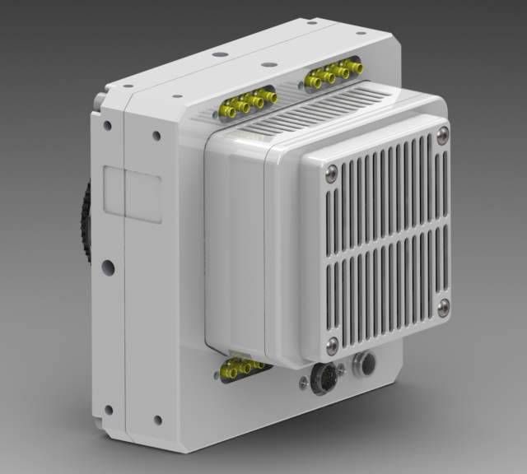
Phantom S890 Design
Dimensions:
  5 ¾ x 5 ¾ x 3 ¾ inches, without lens mount
  14.6 x 14.6 x 9.525 cm, without lens mount
Lens mounts are interchangeable

Slide 4
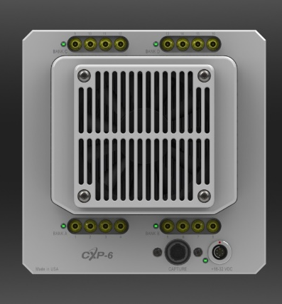
S890 Design
GPIO port:
Hirose 12-pin
Power port:
Mini-xlr
C110 Power supply (80W)
Goal: Remove in final product, power over CXP
CXP ports:
Strain relief / Cable management to be designed

Slide 5
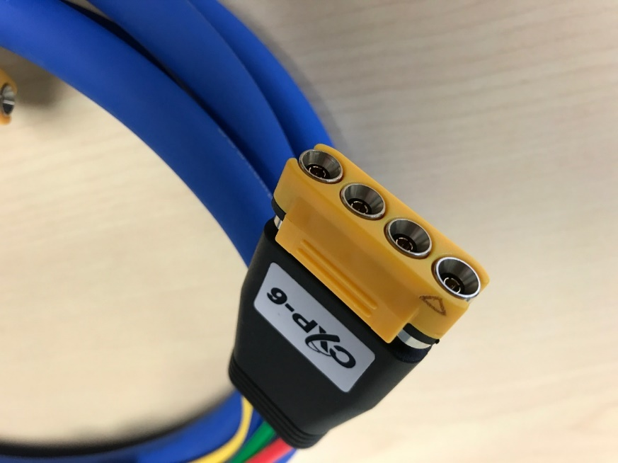
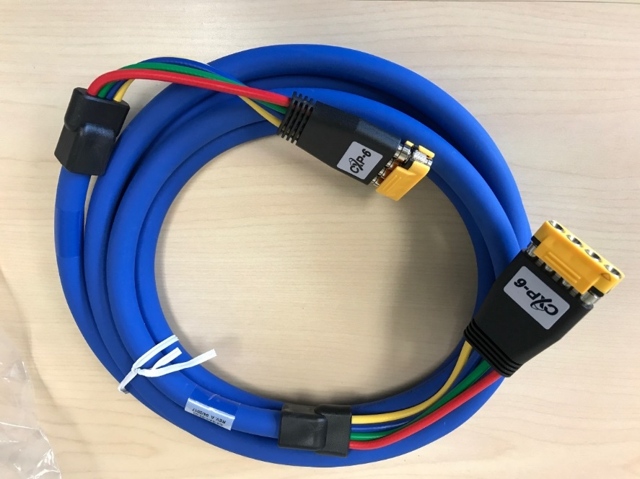
S890 Design – Cables
Cable options for various use cases
Frequent need to connect / disconnect: Standard single or double CXP cables
Need to ruggedize connection: CXP cables with screw-in connectors
Connect once, maintain connection: Ruggedized, 4-connector CXP cables

Slide 6
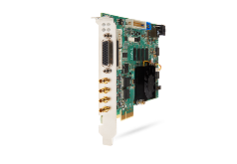

Final Work Flow
4 x Frame Grabbers
Image Processors (Halcon, Matrox, etc)
4 x CXP 6
Computer with PCIe Gen 3 Slots
4 x CXP 6
Recommended Image Viewer: Euresys
4 x CXP 6
Signals:
FSYNC (in/ out)
Strobe (out)
Trigger (SW)
Event
Memgate
IRIG (unmodulated)
4 x CXP 6
When Streamer establishes CXP link with FG SW:
transmits raw images as 1 to 4 virtual cameras
Corrects pixels
Offset/gains accessible via xml (not CXP standard)
Color – Raw data
Headers in image data for time stamp
Images are captured 12-bit, transmitted in either 8-bit or 12 bit
When FG receives images:
DMA’s image data in to PC ram
User program stitches data into 1 image
When Viewer/Integrator receives images (Via Gen-i-Cam):
Camera control
Manages resolution / speed
Performs color interpolation
Performs white balance
Adjusts bit-depth
Places time stamp in header

Slide 7
Phantom S890
Specifications

Slide 8
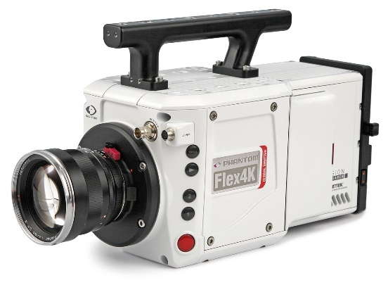
Preliminary Specifications
Flex 4K GS Specifications
  9.4 Megapixel Resolution
  4K at up to 800 fps
  Increased frame rates at reduced resolutions
  CMOS Sensor: 4096 x 2304 pixels
  6.75 µm pixel size
  27.6 mm x 15.5 mm
  Global Shutter (GS), Switchable to Rolling Shutter (RS)
  Available in Monochrome or Color
  GS ISO: 5,000 (T) Mono, 640 (T) Color
  RS ISO: 2,000 (T) Mono, 320 (T) Color
phantomhighspeed.com

Slide 9
Preliminary Specifications
Streamer Specifications
  Up to 8 Gpx/second data transfer
  8-bit or 12-bit
  CXP 6
  Standard DIN connectors
  Data transfer capacity available in increments of:
    2 Gpx/s
    4 Gpx/s
    8 Gpx/s
  Data transfer is scalable for reduced data needs
  80W power supply
phantomhighspeed.com

Slide 10
Signals
,
Signals included:
  Trigger (FSYNC) In/Out: One hardware pulse per frame (= image) to synchronize image acquisition (and potentially drive a variable frame rate) with an external process (either in or out)
  Trigger (SW) to start stream: One hardware pulse per recording, to start and/or stop the recording, depending on pre/post-trigger settings (often in, sometimes out)
  Strobe
  Time code (IRIG) In/Out - 5us accuracy
  Event marking: Places flag in header data
  Memgate: begins acquisition at signal, and continues acquiring
  Ready
GPIO port:
Hirose 12-pin
  >=2 opto-isolated
  3 TTL bi-directional

Slide 11
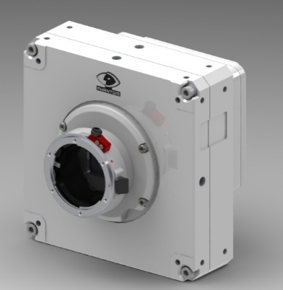
Pricing & Availability
Pricing Structure:
Per unit price will reduce based on total annual volume
Pricing includes:
  Streamer, with Nikon Mount
  Power supply
Priced separately:
  CXP cables
  Frame grabber cards
Availability:
  April 30

